Slide 1


SAP base Microprocessor Design
Supervisors:
Dr. Islam Yehia
TA. Zeina Mohamed

Slide 2
Our team
Omar Elshopky
Mohamed Kamal
Hoda Ashraf

Slide 3
Table of contents
01
02
03
04
05
Project Scope and Objectives
Project Management
Microprocessor Architecture
Instruction Set Architecture
Implementation & Verification

Slide 4
01
Project Scope and Objectives
02

Slide 5
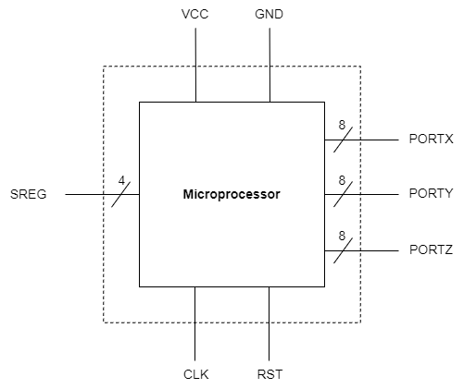
Microprocessor Design Overview
8-bit Microprocessor follows the RISC architecture
4 programmer-accessible registers, A, B, C, and D
3 output ports, to display the content of the internal registers.
Dynamic stack, enhance the capability of executing multiple subroutines calls.
Direct, immediate, and register-based addressing modes.
4-bit Status Register contains flags Zero, Carry, Parity, and Sign.
Single bus following the Von Neumann Architecture

Slide 6
Microprocessor Specifications
Data width of 8 bits, with 64kb RAM
12x 8-bit Register File. Among them are 4 programmer-accessible registers, Status Register, and three 16-bit addressed Stack Pointer, Temp, and Program Counter.
Perform Addition, Subtraction, Increment, Decrement, Multiplication and Division by 2, AND, OR, XOR, and Rotation.
Conditional and Unconditional Jump, and Call & Return

Slide 7
Project Goals
Microprocessor design, ranging from high-level conceptualization to detailed sub-block designs.
A programming guide outlining the instruction set in assembly, hexadecimal, and binary formats.
Verilog implementation of the designed sub-blocks, integrated and verified to form the desired microprocessor.
An assembler developed in Python to convert assembly instructions into a binary file ready for execution.
Showcasing the microprocessor’s verification on FPGA

Slide 8

02
Project
Management
02

Slide 9
Project Phases
RTL Implementation & Unit Testing
Final Report Creation
Project Initiation
1
2
3
4
5
Microprocessor Architecture Design
Simulation, Verification & Assembler

Slide 10
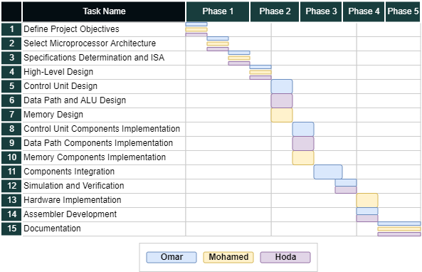

Slide 11
03
Microprocessor Architecture
03

Slide 12
Choice of Microprocessor Architecture
SAP-2
SAP-3
Bidirectional Registers.
Reducing wiring capacitance and the count of I/O pins.
Larger Memory
Dynamic Stack
Advantages for applications depend on subroutines.
Register File
Reduce the number of memory-reference instructions.
Multiple key points
Of other microprocessor architecture

Slide 13
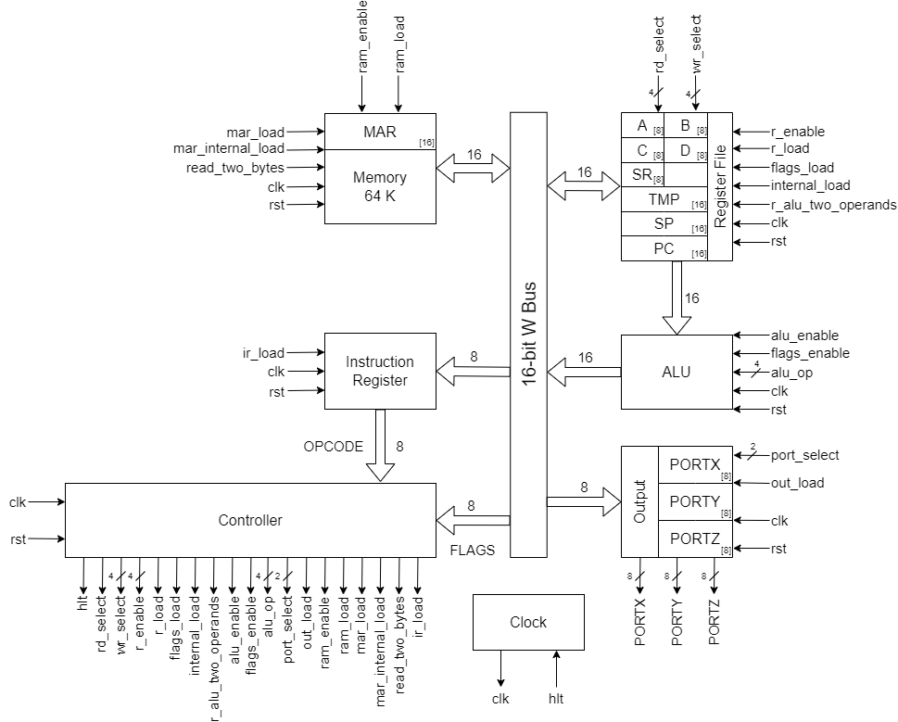

Slide 14
04
Instruction Set Architecture
05

Slide 15
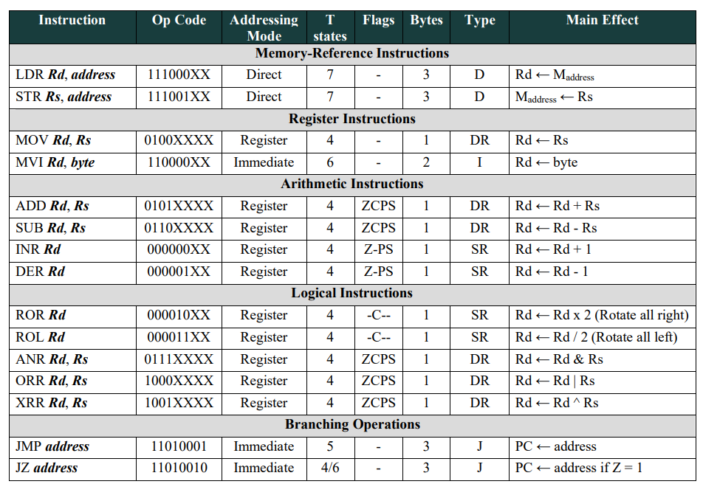
Macroinstructions

Slide 16
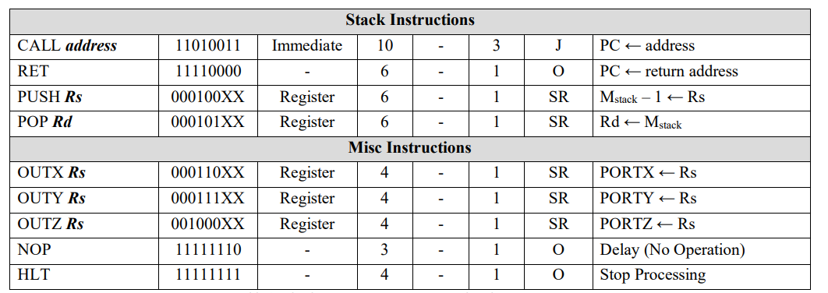
Macroinstructions

Slide 17
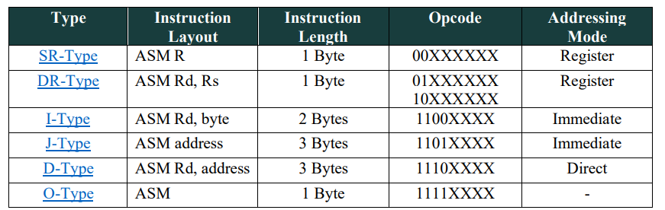
Instruction Formats

Slide 18
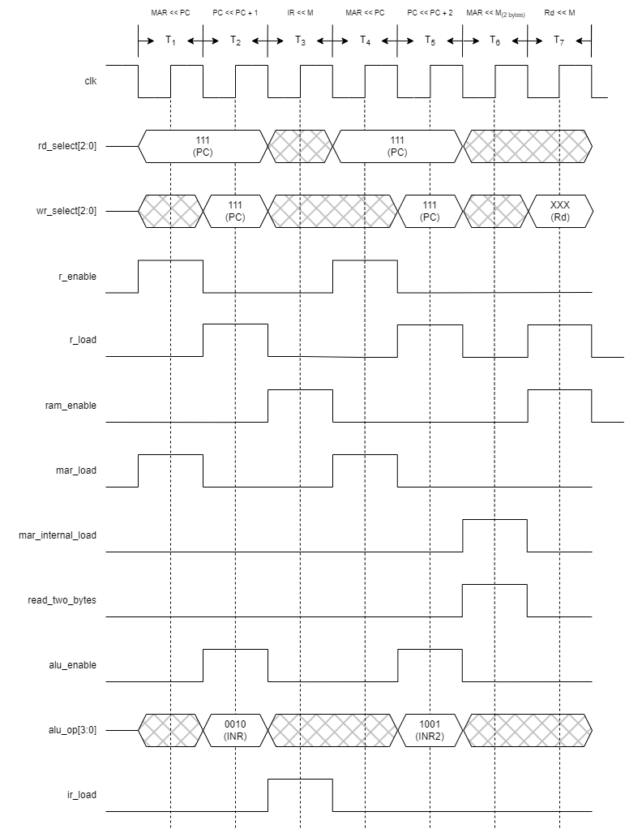
LDR Timing Diagram

Slide 19
05
Implementation & Simulation
03

Slide 20
Controller
The controller depends on two ROMs: one stores the control words for all stages of each instruction, and the other stores the first address of each instruction in the control ROM.
Control ROM
The ROM has a width of 29 bits to accommodate the 29 control signals, with a length of 256 to hold a total of 256 microinstructions.
Address ROM
The ROM has a width of 8 bits to store the address of the 256-byte Control ROM, with a length of 256 to hold a total of 256 instructions' starting addresses.

Slide 21
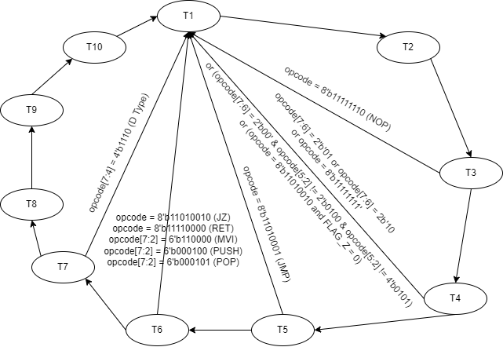
Controller
The controller is also responsible for resetting the counter when the states of the instruction are completed and initiating another fetching cycle.

Slide 22
Hardware Simulation
The FPGA provided for testing imposes a memory limitation of 64 KB for the entire set of blocks.
However, our design includes 64 KB RAM, along with additional control and address ROMs for the control unit and other registers, exceeding the available memory capacity.
To address this constraint, we opted to reduce the RAM size to 32 KB and set the Stack Pointer to 7FFFH.

Slide 23
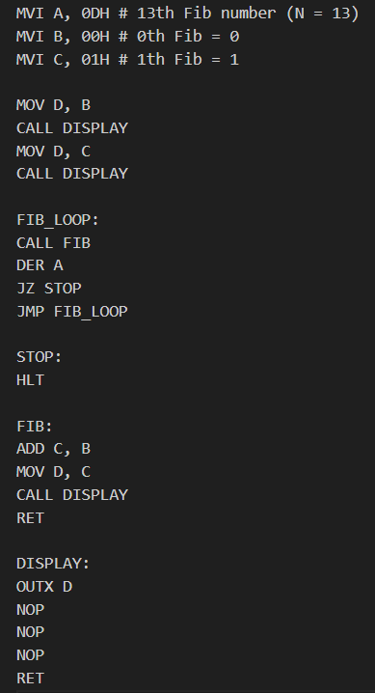
Hardware Simulation - Fibonacci

Slide 24
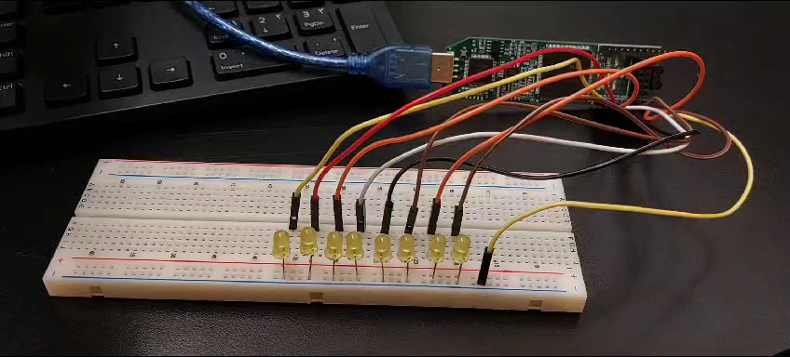
Hardware Simulation - Fibonacci
0, 1, 1, 2, 3, 5, 8, 13, 21, 34, 55, 89, 144, 233

Slide 25
Thanks!
Do you have any questions?

